Slide 1
Enron Email Analysis
Webroot Night
Prepared by Li

Slide 2
Process
1 Collect E-mails
2 Parse key information in E-mails
3 Analyze
4 Visualization

Slide 3
What I Analyze
Internal Network of Enron
External Network of Enron

Slide 4
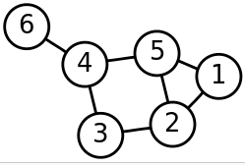
Internal Network of Enron
Who are behind the scandal?
Represent relation in Graph
2) Figure out clique in Graph

Slide 5
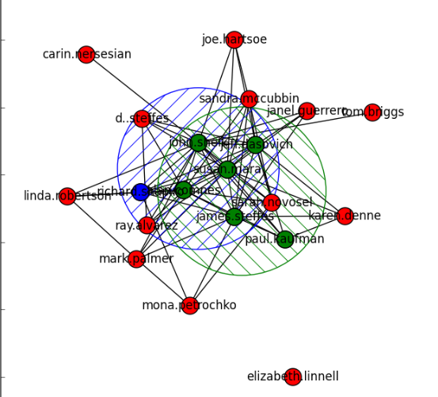
Internal Network of Enron
Clique 0: ['john.shelk', 'susan.mara', 'alan.comnes', 'jeff.dasovich', 'james.steffes', 'richard.shapiro']
Clique 1: ['john.shelk', 'susan.mara', 'alan.comnes', 'jeff.dasovich', 'james.steffes', 'paul.kaufman']

Slide 6
Who are they?
susan J.Mara
James Steffes
….

Slide 7
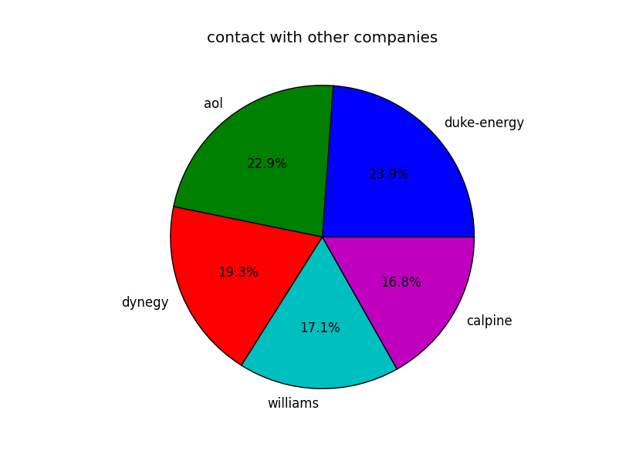
External Network of Enron

Slide 8

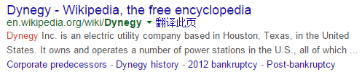
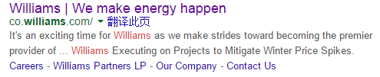
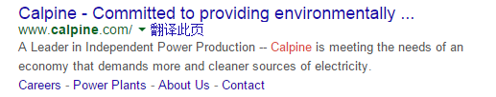

Who are they?

Slide 9
Enron and AOL
financially 5
unfairly 2
Environmentally 5
down 7
n't 37
Dramatically 7
Fiscally 5
cautiously 3
Politically 2

